Slide 1

Date: | Human Biology Year 12 ATAR
Do Now Get out your equipment and textbook. Lesson Agenda 1: Do Now 2: Mutations and Gene Pools into 3: Gene mutations 4: Start on the Review Worksheet 5: Lesson summary and wind-up Suggested Study Complete review worksheet, then mark and correct using the answer key on Connect (compulsory). NEXT LESSON Chromosomal mutations | Learning Aims Define key terms related to gene pools Outline ways in which frequency and type of alleles in a population can change over time. Define and classify mutations Define mutagens and give examples Outline somatic mutations and their effects Define germline mutations and describe the possible effects List and describe the three types of point mutation Describe the effects of point mutations on amino acids and protein structures List and briefly discuss examples of inherited disease from gene mutation including: Albinism Duchenne Muscular Dystrophy Cystic Fibrosis Define the term “lethal recessive” and describe an example
 | Key Vocabulary Mutation Mutagen Substitution Deletion Insertion

Slide 2
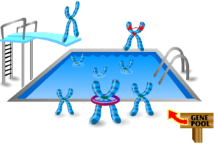
Change in Gene Pools over Time Intro, Gene Mutations
Ch 9 Human Perspectives

Slide 3
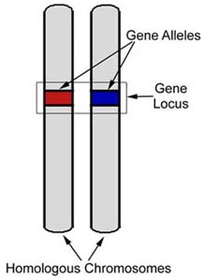
Important Terms and Definitions: Alleles
Alleles are alternative forms of a gene.
For any given gene, one allele (form) is inherited from the mother, and one from the father.
The human genome contains many genes, each coding for different aspects of human structure and function.
For each gene, two alleles are inherited.
The traits an individual shows depends on the alleles inherited for each gene.
Learning Aim: Define key terms related to gene pools

Slide 4

Each half of a chromosome pair contains genes for the same things, but an individual has inherited different variants (alleles) from each parent:
Dimple gene: inherited dominant “dimpling” version from Dad. [D]
Dimple gene: inherited weaker “non-dimpling” version from Mum. [d]
Eg: This person has dimples because the dominant variant (allele) of the gene he got from his dad overcame the weaker variant from his mum. The “dimpling” gene is really a code giving instructions for protein production to the muscles in the cheek, which affects how those cells arrange themselves. One variant of the protein production results in no dimples. The other results in dimples.
Learning Aim: Define key terms related to gene pools

Slide 5
Important Terms and Definitions: Species
Species: a group of individuals that share many characteristics and are able to breed under natural conditions to produce fertile offspring.
Eg: Humans are members of the same species:
Homo sapiens
Chimpanzees are not the same genus or species as humans. They are of the genus and species Pan troglodytes
Neanderthals (extinct human ancestors) are from the same genus as modern humans, but a different species. They are Homo neanderthalensis
Learning Aim: Define key terms related to gene pools

Slide 6
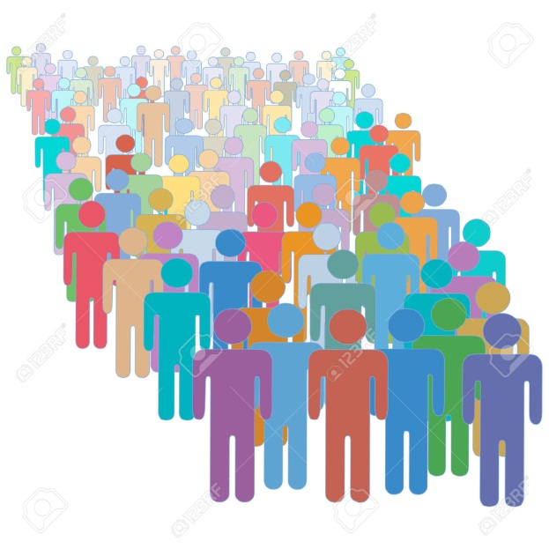
Important Terms and Definitions: Population
A population is a group of organisms of the same species, living together in a particular place at a particular time.
Eg: there is a population of human beings living in Perth right now, and another living in Sydney.
The population in Perth now is a different population than lived here 100 years ago.
Can look at the genes, alleles and
characteristics of a population as a
whole, as well as individuals.
Learning Aim: Define key terms related to gene pools

Slide 7
Important Terms and Definitions: Gene Pool
Gene Pool : The sum of all alleles in a given population
Allele frequency: how often each allele for a gene occurs in a population.
Eg: the alleles for blond hair occur more frequently in Scandinavian populations than they do in Asian populations.
Eg: Allele for Cystic Fibrosis occurs on Chromosome Pair 7
Cystic Fibrosis in Population N:
Frequency of CF allele: 5%
Frequency of normal allele: 95%
Populations with different general characteristics are likely to have different allele frequencies, and therefore different gene pools.
Learning Aim: Define key terms related to gene pools

Slide 8
Change in gene pools over time
Frequency and type of alleles in a population can change over time.
Mutation – can have no effect, produce an advantageous change or produce a disadvantageous change.
Gene Mutation
Chromosomal Mutation
Gene flow due to interbreeding between adjoining groups
Change to allele frequency via genetic drift
Random
Non-directional – frequency can drift back and forth
Natural selection -
alleles that provide an advantage to individuals in the environment increase in frequency.
alleles that provide no advantage decrease in frequency.
change to allele frequency is directional – increase in frequency of advantageous alleles.
Learning Aim: Outline ways in which frequency and type of alleles in a population can change over time

Slide 9
Mutations
Changes to gene sequences or chromosomes
Occur during replication of DNA molecule before cell division.
Can be classified by:
WHAT CAUSES THEM TO OCCUR
Spontaneous (occur randomly)
Induced (are the result of a mutagen)
WHETHER THEY CAN BE INHERITED
Somatic (non heritable)
Germline (heritable)
THEIR EFFECT ON AMINO ACID SEQUENCE and PROTEIN PRODUCTION
Missense, Nonsense, Neutral and Silent mutations have differing effects
HOW MUCH DNA IS AFFECTED
The base sequence for an individual gene (point mutation)
Larger sections of DNA (chromosomal mutation)
Learning Aim: Define and classify mutations

Slide 10
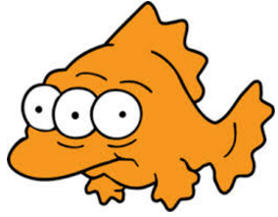
Mutagens
Some mutations arise by chance. These are spontaneous mutations.
Others are caused by a mutagen. These are induced mutations.
Mutagen: a substance or agent that affects the rate of mutation of DNA.
Ionising radiation:
UV light
X-rays
Nuclear radiation and more…
Some chemicals:
Mustard gas
Formaldehyde
Some antibiotics and other drugs
And more…
Learning Aim: Define mutagens and give examples

Slide 11
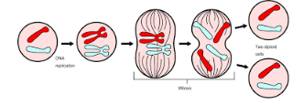
Somatic mutations
Occur in non-reproductive cells, during mitosis – therefore affects only that individual, not offspring or population.
May:
Have no effect on cell-line function
Cause cell death
Cause uncontrolled growth and structure of the cell-line tissue: cancer.
Mutation is not passed down to further generations of organism: the sperm or egg cells aren’t affected.
Learning Aim: Outline somatic mutations and their effects

Slide 12
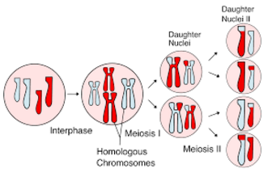
Germline Mutations
Germline cells = reproductive cells/gametes eg sperm and egg
Germline mutations occur in gamete production, during meiosis
Changes may:
Be passed on to offspring, subsequent generations and population over time.
Result in a non-viable gamete
Have no obvious effect
Have a negative effect: abnormalities, inherited disease
Have a positive effect: advantage for the individual and therefore for offspring and the population over time.
Learning Aim: Define germline mutations and describe the possible effects.

Slide 13
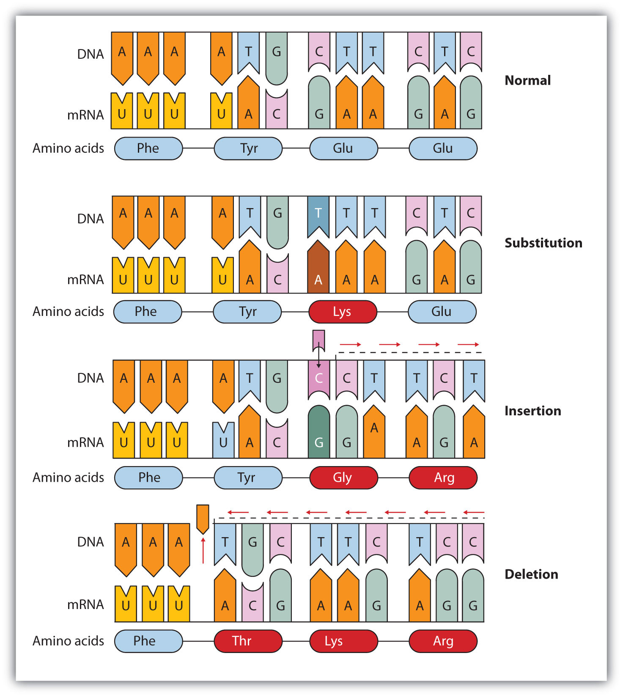
Gene (point) mutations
Affect individual genes (not large chromosome chunks)
Change the base sequence in the genetic code.
Can alter structure and function of the protein made using the code.
Change in the base sequence can be:
Insertion: an additional nucleotide is added to the base sequence.
Deletion: a nucleotide is removed from the base sequence.
Substitution: a nucleotide is replaced with a different nucleotide.
Insertion and deletion will result in a frame shift – they affect every subsequent triplet and therefore the amino acids coded for.
Learning Aim: List and describe the three types of point mutation.

Slide 14
Gene (point) Mutation Effects
Change the base sequence in the genetic code.
Can alter structure and function of the protein made using the code.
May have no effect, may cause problems, or may be an advantage.
Missense mutations cause a change in the amino acid and therefore the protein produced
Nonsense mutations change the base sequence to stop amino acid addition causing the protein to lose structure and function
Neutral mutations cause change in the amino acid but it does not affect protein structure
Silent mutations cause change in base sequence but no change to amino acid or protein – most amino acids are coded for by multiple triplet combos.
Learning Aim: Describe the effects of point mutations on amino acid production and therefore protein structure.

Slide 15
Inherited disease from gene mutation
Base sequence mutation in the germline cells can cause a protein to become faulty or absent, which can result in a disease inherited with each new generation.
These diseases are often recessive – both inherited alleles must be faulty for the person to develop the disease.
A person who has one faulty allele will not have the disease, as one allele will still produce the correct protein, but they can pass that allele on to offspring.
Learning Aim: List and briefly discuss examples of inherited disease from gene mutation.

Slide 16
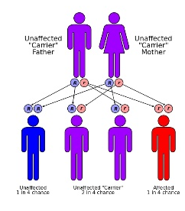
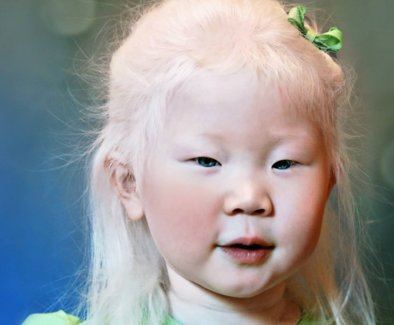
Inherited disease from gene mutation Example: Albinism
Allele for pigment production is faulty
People who inherit two faulty alleles will have albinism. (Autosomal recessive inheritance)
Cannot produce pigment for skin and hair
White blond hair
Extremely pale skin
Extremely pale blue eyes
Learning Aim: Discuss the genetic cause of albinism and features of albinism

Slide 17
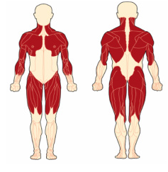
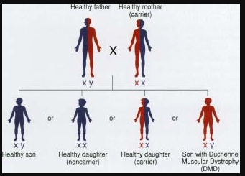
Inherited disease from gene mutation Example: Duchenne Muscular Dystrophy
Faulty gene allele for a protein required for muscle development, on chromosome pair 23. Usually caused by base deletion.
Wasting of leg muscles, arm, shoulders and chest
Death due to respiratory failure
Survival unlikely past 20 years old.
Recessive – if one healthy allele is present, protein can still
be made.
Mother is carrier, can pass on disease to her sons.
X-linked inheritance
Can also occur as a spontaneous mutation in gamete/zygote.
Learning Aim: Discuss the genetic cause of DMD and symptoms of DMD

Slide 18
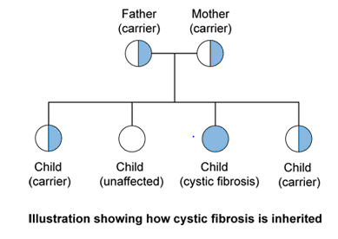
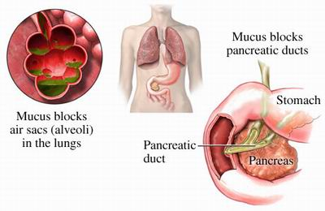
Inherited disease from gene mutation Example: Cystic Fibrosis
Mutation on chromosome 7.
Faulty allele for gene (1480 amino acids long) that regulates chloride ion movement across cell membrane. Usually caused by base deletion.
Autosomal recessive inheritance: if one normal allele is present, protein will still be made.
Affected individuals:
Mucus is stickier than unaffected individuals
Causes problems with respiratory and digestive systems
Learning Aim: Discuss the genetic cause of CF and symptoms of CF

Slide 19
Inherited disease from gene mutation – Lethal Recessives Example: Tay-Sachs Disease
Some autosomal recessive conditions (where the condition occurs if the child inherits two faulty alleles for a gene) are lethal.
Cause death of embryo, foetus or very young child
Eg: Tay-Sachs Disease (TSD)
Disorder of lipid metabolism – faulty code for an important enzyme
Causes accumulation of fatty substance in brain
Death occurs in early childhood
Must inherit two faulty alleles to be affected. If only one inherited, person will be a carrier of the faulty allele, but can still make the enzyme.
Learning Aim: Define the term “lethal recessive” and give an example.

Slide 20
Inherited disease from gene mutation – Lethal Recessives Example: Tay-Sachs Disease
Because people who are affected die before they can reproduce, proportion of lethal recessive alleles in the gene pool will slowly reduce, unless the population is small (with a higher chance of two carriers reproducing).
Tay-Sachs mutation exists at a higher frequency in Ashkenazi Jews, a small population who usually marry others from the group
Gene frequency of the lethal allele is higher in these populations than the general population.
1 in 29 Ashkenazi Jews carry the Tay-Sachs allele
1 in in 250 people in the general population carry the Tay-Sachs allele.
Learning Aim: Define the term “lethal recessive” and give an example.

